Slide 1
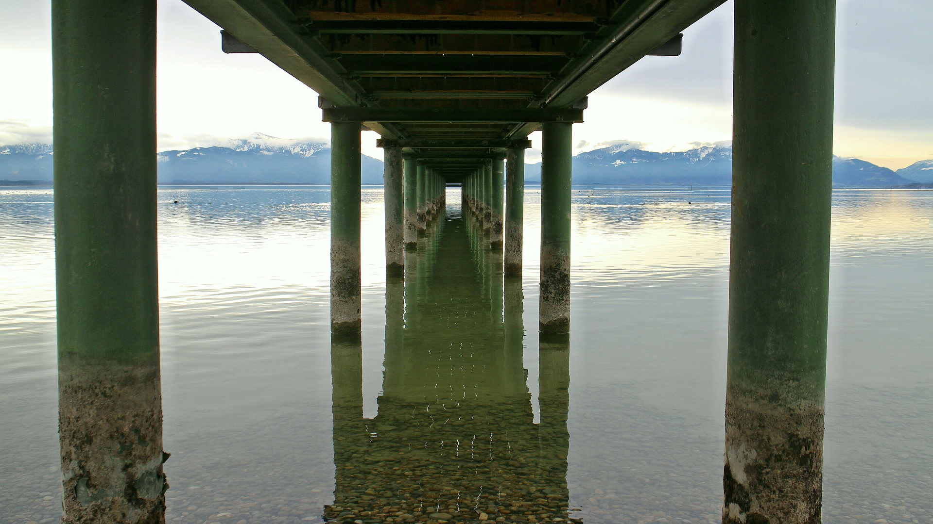
THE 4 AIMS OF TOK
BQ1 Foundations Lesson 1
I can explain the 4 aims of TOK, and evaluate their importance
Notes:
See how this lesson links to the course by viewing the final slide
Key TOK terms appear in a red font

Slide 2
Starter
Individual - What do you think the point of TOK is?

Slide 3
Task 1
In pairs -
Read your story about Covid-19.
Why do you think your story was believed and shared by so many people?
How readily do YOU believe stories like this? Be honest!
Notes:
STORY 1 Chinese court to seek permission to kill 20,000 Covid-19 patients (Debunk here)
STORY 2 Garlic can prevent the spread of Covid-19 (Debunk here)
STORY 3 Corona beer sales have been affected by the pandemic (Debunk here)
STORY 4 5G towers help spread of Covid-19 (Debunk here)
Assign each pair in the class a story and provide links. Set this up by telling the students that not all of these stories are true. Ask them to think about why they were so widely believed (NOT whether or not they are true). Draw on use of language, valid-looking source, fallacy of authority, our own biases, etc., etc.
Reveal the last bullet point, and tell them that none of the stories are real. Ask them to respond to the final question, and then quiz them on how we can tell what’s real and what’s fake when we read about what’s going on in the world.

Slide 4
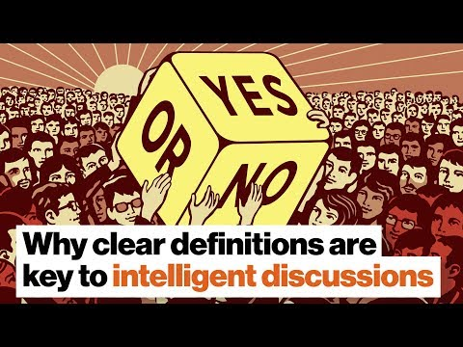
Task 2
Watch the video featuring Donald Hoffman.
What is his overall point about the knowledge claims we make?
Which areas of knowledge does he say this is particularly important in?
Notes:
Watch the video until 3.10

Slide 5
Task 3
In groups - Design an instrument for telling the time
Make it original
It does not have to be 100% accurate
Notes:
Students will need large white paper to create their designs.
Give them approx. 15 minutes for this task.
They should then present/explain to the rest of the class how their design works, and the name they came up with for it.

Slide 6
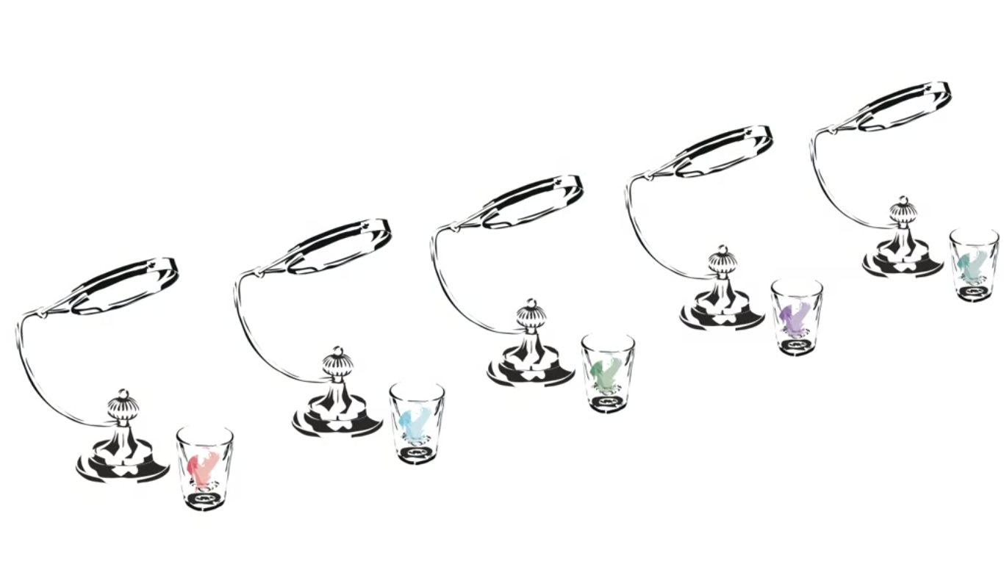
Notes:
Chris Hosmer’s perfume clock - see Jinsop Lee’s TED talk
As the sun moves across the sky (yes, I know this is inaccurate science…) its beams of light move from one magnifying glass to the next. The shot glasses contain different perfumes, so a different scent is created at different times of the day.
In other words, you use your sense of smell to tell the time - Wow!
Most/all student designs involve telling the time via the visual sense, because that’s what you are used to. But in this design, you smell the time - a fantastic conceptual leap (creativity!).

Slide 7
Task 4
Look at the Atlantic article on Thomas Edison. Focus on paragraphs 10 - 12 (“But comparing them… pear-shaped bulb”)
How was Edison’s approach to science and innovation different to Tesla’s?
What was the result of this - for both men?
Notes:
Atlantic article here. Note that you may only access a limited number of Atlantic articles per month - so make sure you haven’t exceeded this limit before running the lesson.

Slide 8
Putting it all together
In pairs - for each of the four tasks we have just done, identify the skill, or type of thinking, that was involved

Slide 9
Our four aims in TOK...
Task 1 was about… CRITICAL THINKING
Task 2 was about… COMMUNICATION
Task 3 was about… CREATIVITY
Task 4 was about… COLLABORATION
Notes:
Teacher led - These are the ‘4Cs’ identified by educational, scientific, and business thought-leaders as being the essential skills to prepare students for a world that is developing quickly, and in which the job market is incredibly unpredictable.
Questions/tasks you could set students to promote further thought:
Which of these 4 aims do you think is most important - why?
Why do you think these have been identified as the most important skills in education (more than, say, learning content)?
Given that TOK aligns so well with the ‘4Cs’ (more, arguably, than any of the other DP subject), does this mean that it is the most important element of the DP?
Research the 4Cs; here’s an article to get them started.

Slide 10
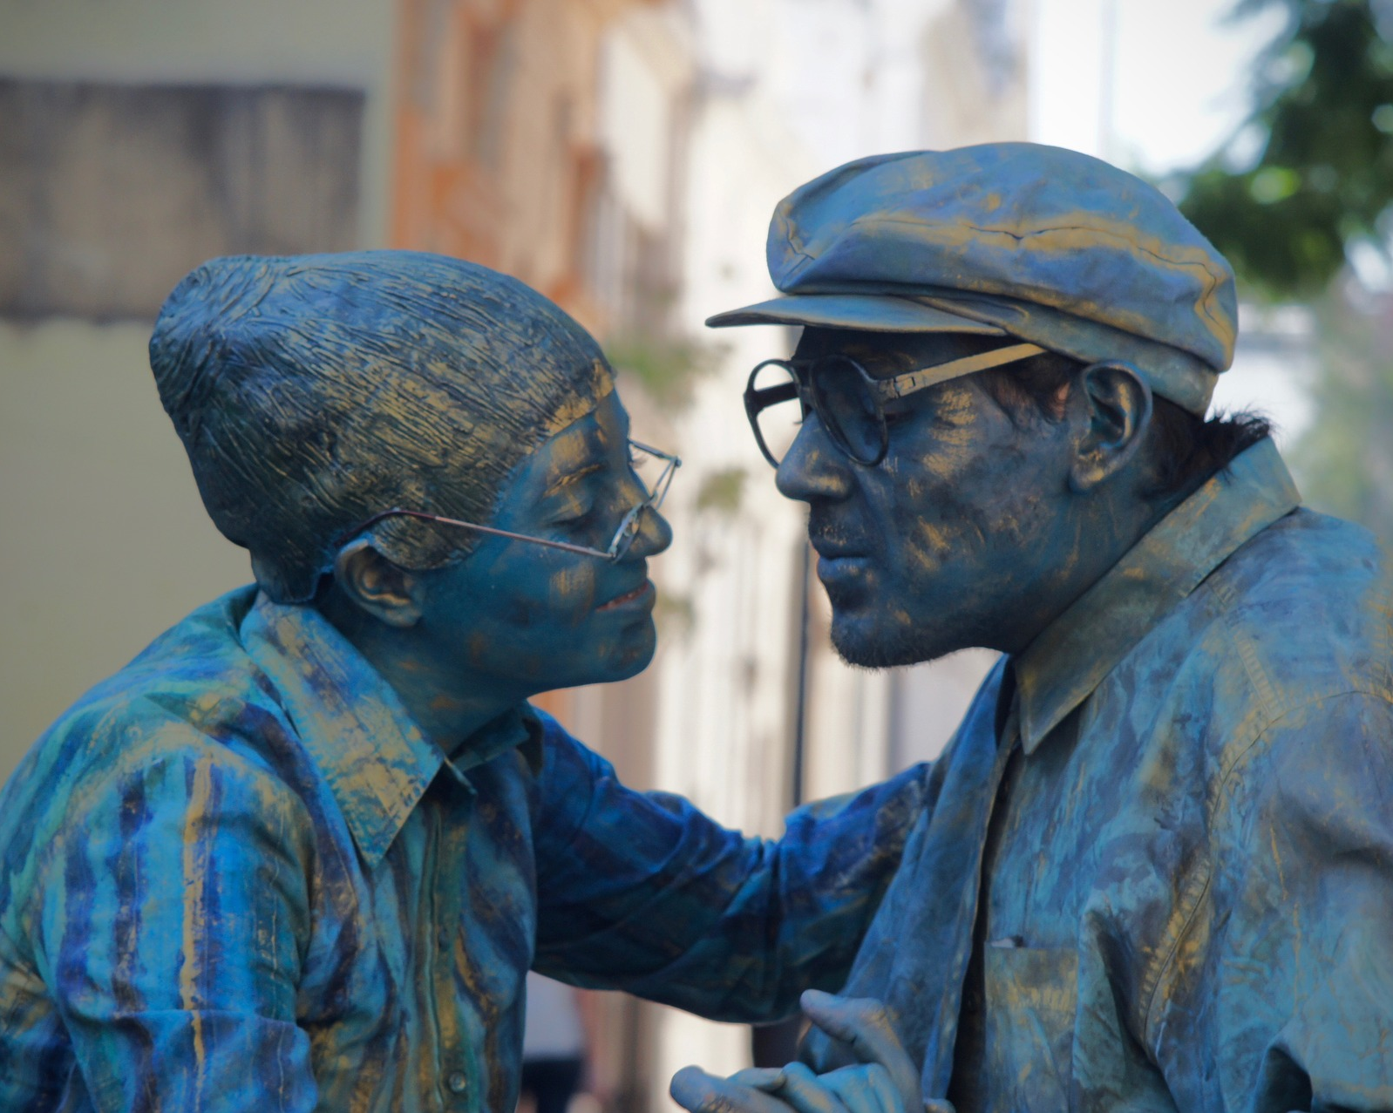
Processing this
In groups of 4, create a ‘living statue’ to represent the aims of TOK.
You have 8 minutes to prepare this.
You must NOT move when you present your statue.
Groups will peer assess the other living statues.
Notes:
Optional activity if you have time.
Give class 8 minutes to prepare this.
Then half the class to present their statue, and the other half assess; then swap round. Teacher to identify one group that has done a stand-out job.

Slide 11
The 4Cs
& the learner profile
Have a look through the 10 learner profile attributes.
How do these link to our aims for the course? Can you relate all the attributes to the ‘4Cs’?
Notes:
Teachers should provide students with a link to the 10 learner profile attributes, or display on the board.
Discuss with students how these align.

Slide 12
Links to the TOK exhibition
Related exhibition prompt Why do we seek knowledge (IAP-17)?
Refer to the ideas from this lesson to answer this question.
For example, why are we studying this course - and trying to improve our understanding of what knowledge is? How could this help us to navigate the world more effectively?
Which objects could help to illustrate your answer?
Notes:
Optional slide, if you want to help students to take ownership of the IA prompts (IAPs) for the TOK exhibition
For more ideas on relevant IAPs, see the ‘Linking this lesson to the course’ slide

Slide 13
Are you a ‘TOK thinker’? Justify your answer.
Notes:
Use post-it notes to get responses. All students to pin to wall before they leave the classroom.
Highlight the ones in the follow-up lesson who justified their answer the best.
See the BQ1 assessment tracker for suggestions on providing feedback, and recording students’ progress

Slide 14
Linking this lesson to the course
During this lesson, we consider the highlighted aspects of the TOK course
The images used in the presentation slides can also give students ideas about selecting exhibition objects; see also our link below to a specific IA prompt
CORE THEME | OPTIONAL THEMES | AREAS OF KNOWLEDGE | TOK ASSESSMENT
Knowledge & the knower | Indigenous societies | The arts | The TOK essay
 | Language | History
 | Politics | The human sciences | The TOK exhibition Could be linked to IAP-17 (purpose)
 | Religion | Mathematics
 | Technology | The natural sciences

Slide 15
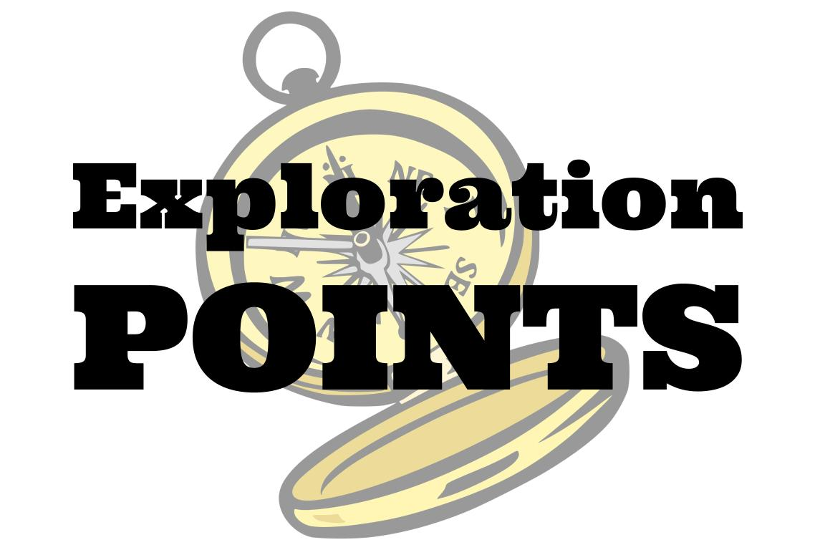
Explore the TOK themes and areas of knowledge in more depth via a range of thinkers, media sources, and other resources, in our EXPLORATION POINTS DOCUMENTS.
Access the documents via the links below. You’ll also find the EP icons on all of the TOK course pages of the site to help you unpack the quotes, KQs, and real-life situations that you find there.
CORE THEME
Knowledge & the knower
OPTIONAL THEMES
Indigenous societies
Language
Politics
Religion
Technology
AREAS OF KNOWLEDGE
The arts
History
Human sciences
Mathematics
Natural sciences
Notes:
Use this slide to access the ‘Exploration Points’ notes for BQ1, which will help students to develop a deeper knowledge of any TOK theme or area of knowledge. This will not only help them to master the TOK course in general, but also craft a great exhibition or essay.
Be ready to provide more guidance on how to use this resource - ie, which media sources to focus on, which questions to address, which TED talks to watch, and which key terms and ideas to understand.

